Slide 1



Automatic Visitor Detection System
B.TECH II YEAR | CSE | AY 2026-27, ODD SEMESTER
Distance-aware doorbell with RGB indication, buzzer and Telegram photo alerts
Jakka Bhanu 2520030006
Anand Akshita 2520030043
Pakalapati Harini 2520030177
Supervisor: Dr. Purva Sharma | Co-Supervisor: Dr. A. Kiran Kumar
Department of CSE, Koneru Lakshmaiah Education Foundation, Bachupally
Notes:
Introduce the project and the team. One line: a doorbell that senses the visitor before the bell is pressed and sends the owner a photo.

Slide 2





Introduction
An entrance monitor that notices a visitor before the bell is pressed.
An ultrasonic sensor measures how close the visitor is, an RGB LED shows the zone, a buzzer rings when the bell is pressed, and an ESP32-CAM sends the owner a photo on Telegram.
Detect
visitor approaching
Measure
HC-SR04 distance
Indicate
RGB LED zone
Capture
ESP32-CAM photo
Notify
owner on Telegram
ESP32-based · low cost · for homes, offices and laboratories
Notes:
Five things the system does, in order: detect, measure, indicate, capture, notify.

Slide 3




Problem Statement
Traditional doorbells react only after the button is pressed, so the owner cannot tell who is approaching, how close they are, or who actually rang.
Owner knows nothing
visitor is already at the door
Visitor arrives
Presses button
Bell rings
No early warning
The owner cannot tell if someone is approaching or waiting outside.
No distance information
Nothing shows how close the visitor is to the door.
No picture of the visitor
There is no photo or remote view of who rang the bell.
Need: a low-cost system that senses, indicates, alerts, photographs and notifies.
Notes:
Traditional bells give no warning, no distance and no photo. That is the gap this project fills.

Slide 4
Objectives
Detect approaching visitors
Measure the visitor’s distance
Show the zone on an RGB LED
Sound a buzzer when the bell is pressed
Capture the visitor’s image
Send the photo to Telegram
Notes:
Six objectives, one per feature of the system.

Slide 5
Existing vs Proposed System
Traditional doorbell
Visitor
Button press
Alert
Reacts only after the press: no distance, no photo
Smart video doorbell (Ring, Nest and similar)
Motion / press
Camera
Cloud
App alert
Live video and two-way talk, but higher cost and cloud dependence
Proposed system
Detection
Distance
Alert
Image
Remote notification
Senses early, shows the zone, rings, photographs and reports to the owner
Notes:
Traditional bell: press then alert. Smart video doorbells such as Ring or Nest add a camera, cloud and app alerts. Ours adds early distance awareness before the press, at low cost.

Slide 6
Smart Video Doorbell vs Ours
Feature | Smart video doorbell | Our system
Visitor detection | Camera motion / PIR sensor | Ultrasonic distance sensor
Distance to visitor | Not shown | RGB LED zone + cm on Telegram
Alert | App push, live video, two-way talk | Buzzer, LED, Telegram photo
Video | Live and recorded | Still photo on button press
Cost | Higher; cloud plan for recordings | Low-cost parts, no subscription
Customisation | Closed ecosystem | Open firmware, easy to extend
Ours trades live video for early distance awareness, low cost and full control.
Notes:
Smart video doorbells are more capable on video and talk-back. Our strength is the distance zones before the press, low cost with no subscription, and open firmware that can be extended.

Slide 7
System Block Diagram
HC-SR04
TRIG 5 · ECHO 18
ESP32
main controller
RGB LED
GPIO 25 · 26 · 27
Buzzer
GPIO 32
Visitor
at the entrance
Push button
GPIO 33
ESP32-CAM
D23 → IO13
Wi-Fi
Telegram
owner notified
Sensing → Processing → Indication → Alert → Image capture → Remote notification
Notes:
Walk left to right: visitor, sensor and button as inputs, ESP32 as the controller, RGB LED, buzzer and camera as outputs, Telegram at the end.

Slide 8
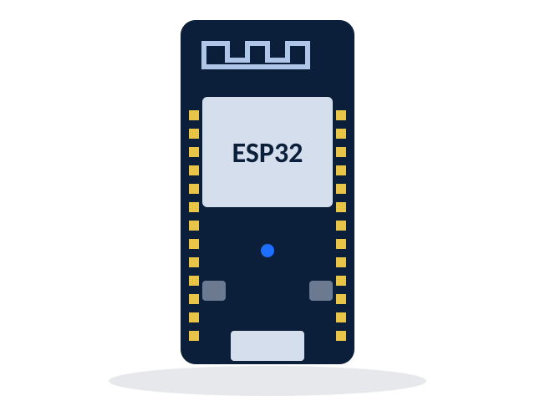
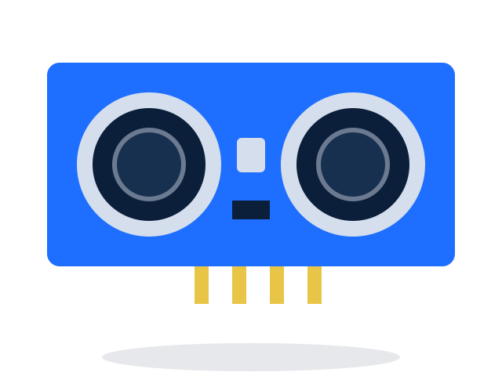
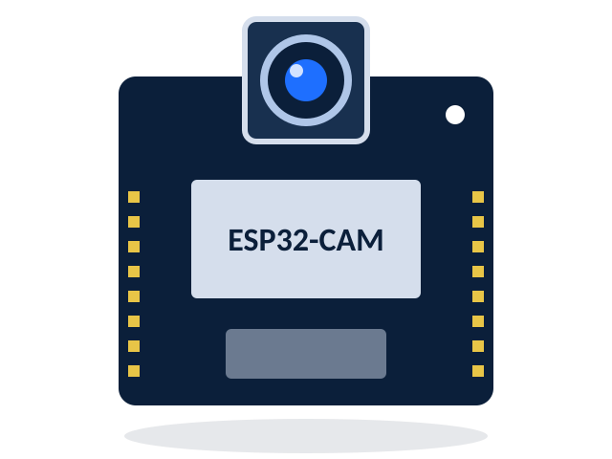




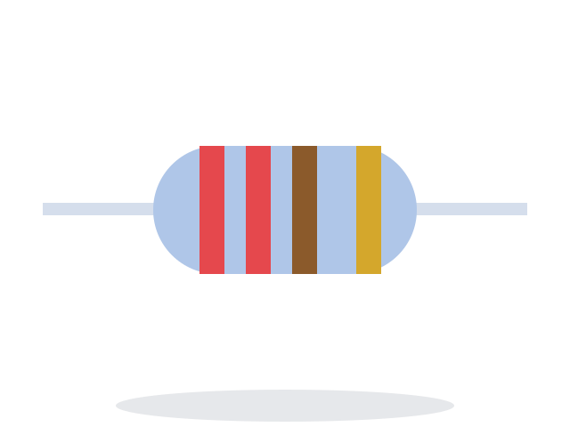
Hardware Components
ESP32
Main controller
HC-SR04
Ultrasonic distance sensor
ESP32-CAM
Image capture and Wi-Fi
RGB LED
Zone indicator
Push button
Doorbell input
Buzzer
Audible alert
FTDI adapter
Programs the ESP32-CAM
Resistors
220 Ω × 3, 1 kΩ + 2 kΩ
Notes:
Eight parts. The FTDI adapter is only needed to upload code to the ESP32-CAM.

Slide 9
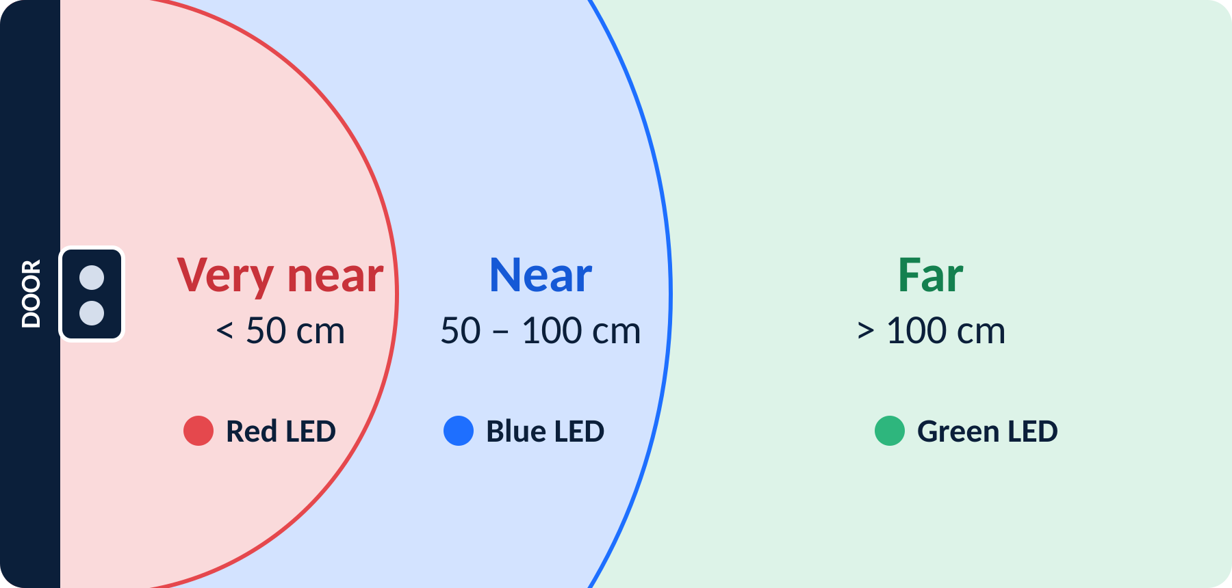

Measuring Distance
ECHO pulse to distance
d = (t × 0.0343) / 2 cm
t = ECHO pulse width in µs
0.0343 cm/µs = speed of sound
÷2 = round trip of the pulse
Zone thresholds are configurable in firmware
TRIG pulse out, ECHO pulse back
1 kΩ + 2 kΩ divider: ECHO 5 V → 3.3 V
Active-LOW RGB: LOW turns a color on
Notes:
Distance comes from the echo time. Far is more than 100 cm (green), near is 50 to 100 cm (blue), very near is under 50 cm (red).

Slide 10
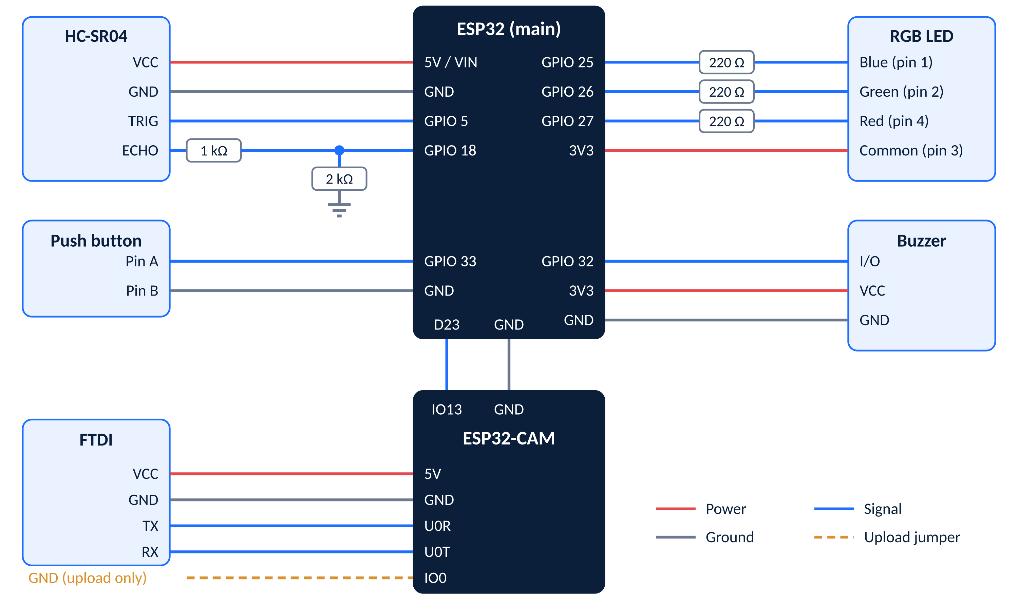
Complete Wiring Diagram
ECHO divider 1 kΩ + 2 kΩ drops 5 V to 3.3 V
RGB LED common on 3V3, LOW = on
Shared GND IO0 → GND only to upload
Notes:
Full pin-level wiring: HC-SR04, RGB LED with three 220 ohm resistors, push button, buzzer, ESP32-CAM and FTDI. Colors: red power, grey ground, blue signal, amber upload jumper.

Slide 11
Working Flowchart
Start
Initialize system
Monitor entrance
Visitor detected?
Yes
Measure distance
RGB LED indication
No: keep monitoring
repeats
Continue monitoring
Telegram notification
Capture image
Buzzer alert
Yes
Doorbell pressed?
No: keep monitoring
Notes:
Two decisions: is a visitor detected, and was the doorbell pressed. After the Telegram message the system goes back to monitoring.

Slide 12
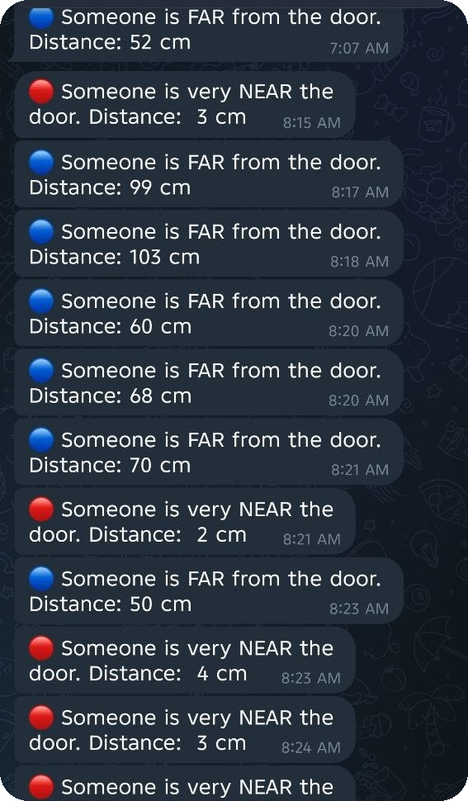

Results: Distance Alerts
The owner’s phone shows the visitor’s distance live
Someone is very NEAR the door. Distance: 3 cm
Someone is FAR from the door. Distance: 99 cm
HC-SR04
ESP32
Wi-Fi
Telegram
Screenshot from the running prototype
Notes:
Real Telegram messages from the prototype: FAR with the distance in cm, and very NEAR when someone is close to the door.

Slide 13
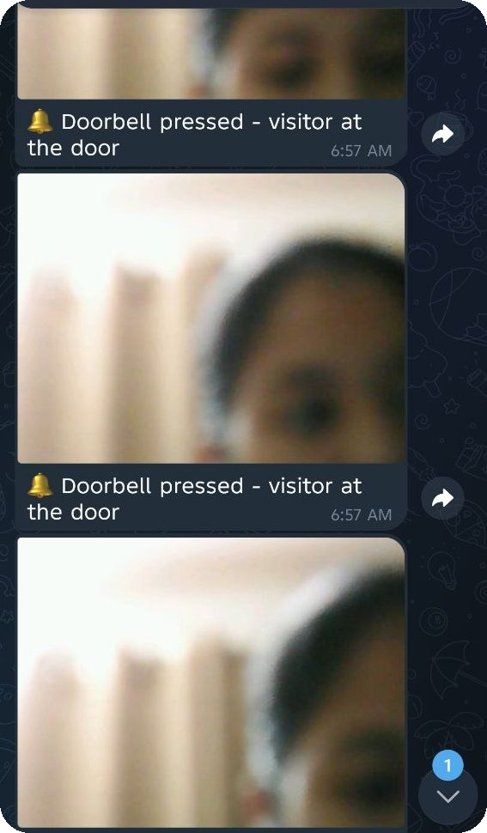
Results: Doorbell Photo
Visitor presses the button
ESP32 reads GPIO 33 going LOW
Buzzer sounds
Audible alert; D23 goes HIGH
ESP32-CAM takes the photo
Triggered on IO13, common ground
Photo reaches the owner
Sent over Wi-Fi to Telegram
Screenshot from the running prototype
Notes:
Each press sounds the buzzer, triggers the camera and sends a photo captioned Doorbell pressed - visitor at the door.

Slide 14





Advantages / Applications
Advantages
Applications
Automatic visitor detection
Early awareness before the press
Homes
Offices
Light, sound and photo alerts
Remote monitoring on Telegram
Low-cost and simple to build
Laboratories
Entrance security
Notes:
Anywhere an entrance needs simple, low-cost monitoring.

Slide 15




Future Scope
Face recognition
Identify known visitors
Cloud storage
Keep a photo history
Mobile app
A dedicated app, not a chat
More sensors
Extra security sensors
Notes:
Possible extensions: face recognition, cloud storage, a mobile app and extra security sensors.

Slide 16
Conclusion
From sensing to notification: one low-cost, automated entrance monitor.
Sensing
Processing
Indication
Alert
Image capture
Remote notification
HC-SR04
ESP32
RGB LED
Buzzer
ESP32-CAM
Telegram
Notes:
Wrap up: sensing, processing, indication, alert, image capture and remote notification combined in one system.

Slide 17
Thank You
Questions?
Jakka Bhanu | Anand Akshita | Pakalapati Harini

